Slide 1
Power Consumption Overhead for Proxy Services on Mobile Device Platforms
Patrick Seeling
Troy Johnson
Central Michigan University

Slide 2
Introduction
Mobile Data Consumption Increasing
Need for energy efficiency and optimizations
Many optimizations come with overheads that incur increased processing and storage burdens
Optimizations need to overcome these overheads before they can yield power savings benefits

Slide 3
Introduction
Measurement framework for the power consumption of mobile devices
Based on the Pandaboard (mobile) development platform using the Android operating system.
Use this framework to evaluate the middle-ware introduced power consumption impact on the power consumption in mobile devices that optimizations schemes need to overcome.
Evaluation based off a mobile SOCKSv5 standard proxy service, adapted to be used with Android devices

Slide 4
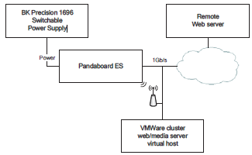
Set up
Pandaboard ES mobile software development platform
Jelly Bean OS
Connected though a 1Gbps maximum speed campus network to eliminate bottlenecks
Externally connected WLAN antenna used for wireless measurements
Locally hosted Apache2 HTTP server running Debian

Slide 5
Performance Evaluation for Web Requests
Application repeatedly requests Google’s home page
Application sleep for 2 seconds between each request
Requests made without utilizing browser
Use as initial baseline for power impact of proxy services
Goal is to evaluate impact of frequent requests through the local proxy server
Fixed Scenario
Pandaboard connected through wired ethernet
Wireless Scenario
Pandaboard connected to network wirelessly

Slide 6
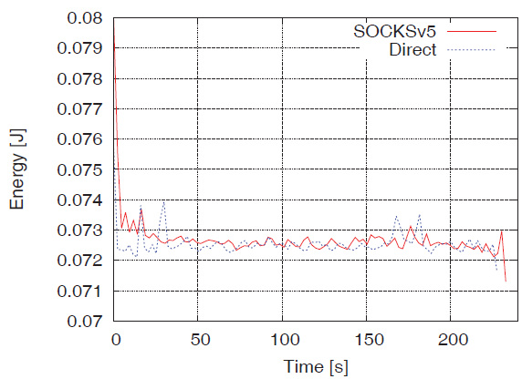
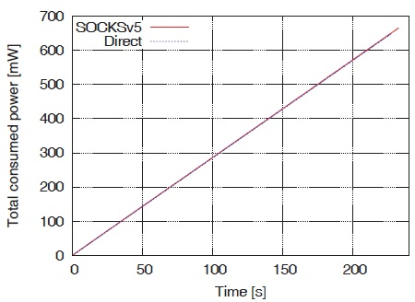
Results
Energy Consumption while performing 100 web requests directly or through a mobile SOCKSv5 service
Results graph similarly for WLAN data
Compounded Energy Consumption for performing 100 web requests directly or through a mobile SOCKSv5 service
Results also graph similarly for WLAN Data

Slide 7
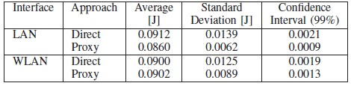
Results (cont.)
Results from LAN and WLAN are close
Proxy doesn’t have significant effect on power consumption
Motivation to further evaluate impact of web request size over WLAN on overall power consumption.

Slide 8
Impact of Web Request Size Variations
Test set up
Dedicate virtual machine that generates an object of a specified amount of bytes
Eliminates potential caching impacts
Performs 100 repeated measurements for a varying object sizes.
Application communicates with server script to generate specified object

Slide 9
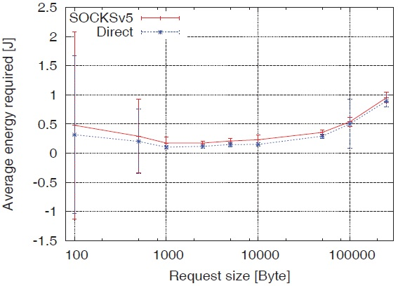
Results

Slide 10
Media Streaming
Evaluate impact of a long duration connection through the mobile SOCKSv5 server
Continuous data stream needs to be forward to local application on mobile device
Streamed Tears of Steel, an open source video sequence

Slide 11
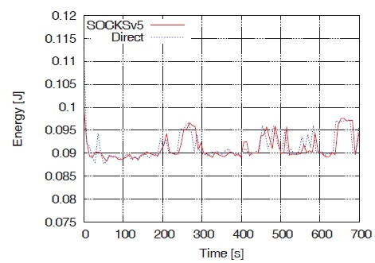
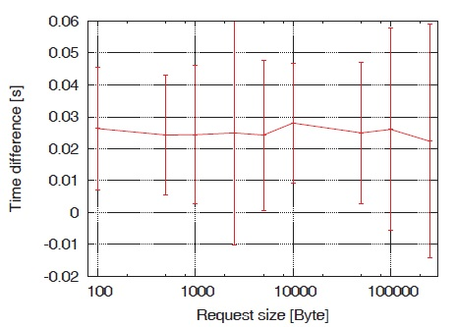
Results

Slide 12
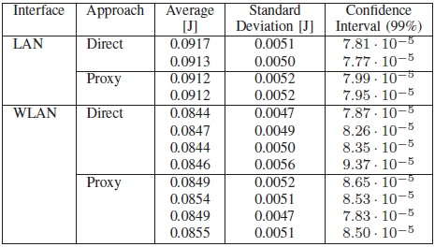
Results
Introduction of mobile proxy server has only limited negative impacts (~1%) on the power consumption when streaming multimedia

Slide 13
Conclusion
Overall usage of a proxy service on the mobile device does not incur any significant power consumption penalties
HTML5 incurs ~1% overhead
Existing overheads are relatively constant and can be explained through the initial communications setup overheads, rather than on-device processing overheads.
Thus, a basic optimization framework would in turn only need to overcome this very low overhead to enable energy savings potentials.

Slide 14
Future Studies
Further energy savings potentials based on mobile device proxying in combination with caching and application layer content awareness in tandem with a remote server.
Transparent application optimization from an upstream perspective

